Slide 1

Enchanted Sleep
Raddison

Slide 2
Mattress Guideline Specification
Division Europe
2
Pocket Spring Mattress (Option 1)
- 1,8mm pocket spring unit, heat‐tempered inner spring unit with approx. 280 springs/m².
- Cover: Flame retardant mattress drill compliant with EN 597‐1 &‐2, sanitized treated.
- Reinforcement frame guarantees high edge stability.
- Incl. 4 turning labels to ensure turning on a regular basis.
- 2 turning handles per side.
- Height of mattress: approx. 30 cm.
- 10 years warranty for innerspring unit against breakage.

Slide 3
Product sizes per bed type:
BED CODE MATTRESS SIZE
“100” Twin 100x200x30 cm
“120” Super Twin 120x200x30 cm
“140” Double 140x200x30 cm
“160” Queen 160x200x30 cm
“180” King 180x200x30 cm
“200” Superkings 200x200x30 cm

Slide 4
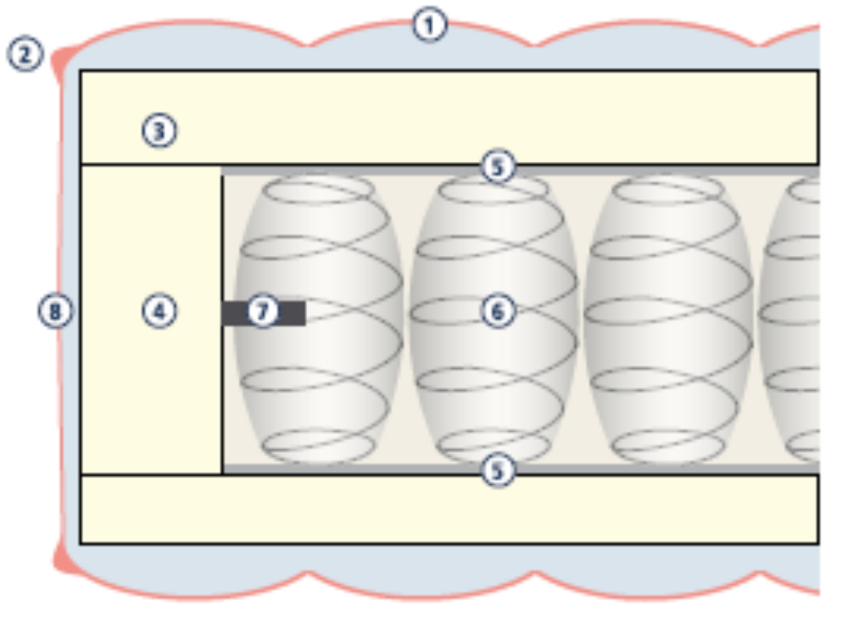
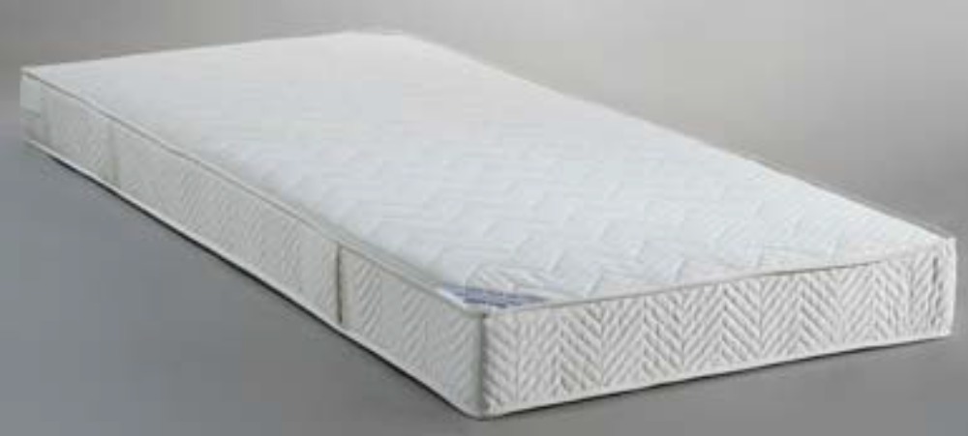
Foam Encapsulated Pocket

Slide 5
Bed Base Guideline/Specification Platform solid top bed base
Multi slatted Bed Base
- Bed base with 15 cross braces
solid timber frame
Glued and fastened for extra strength supporting frame made from solid timber
- Including 4 feet & 2 casters
6 screw in legs as standard
Optimal style legs available
Floating effect bad base
Upholstered in our linoso collection
Customers own fabric is an option if preferred

Slide 6
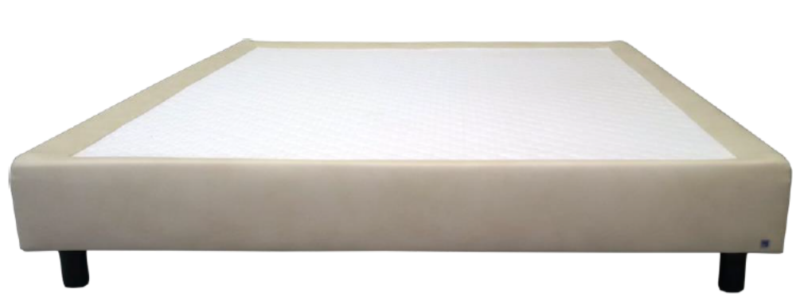
Platform solid top bed base

