Slide 1


MADRID SOFA BED
ALL-IN-ONE-EASY-ACTION

Slide 2
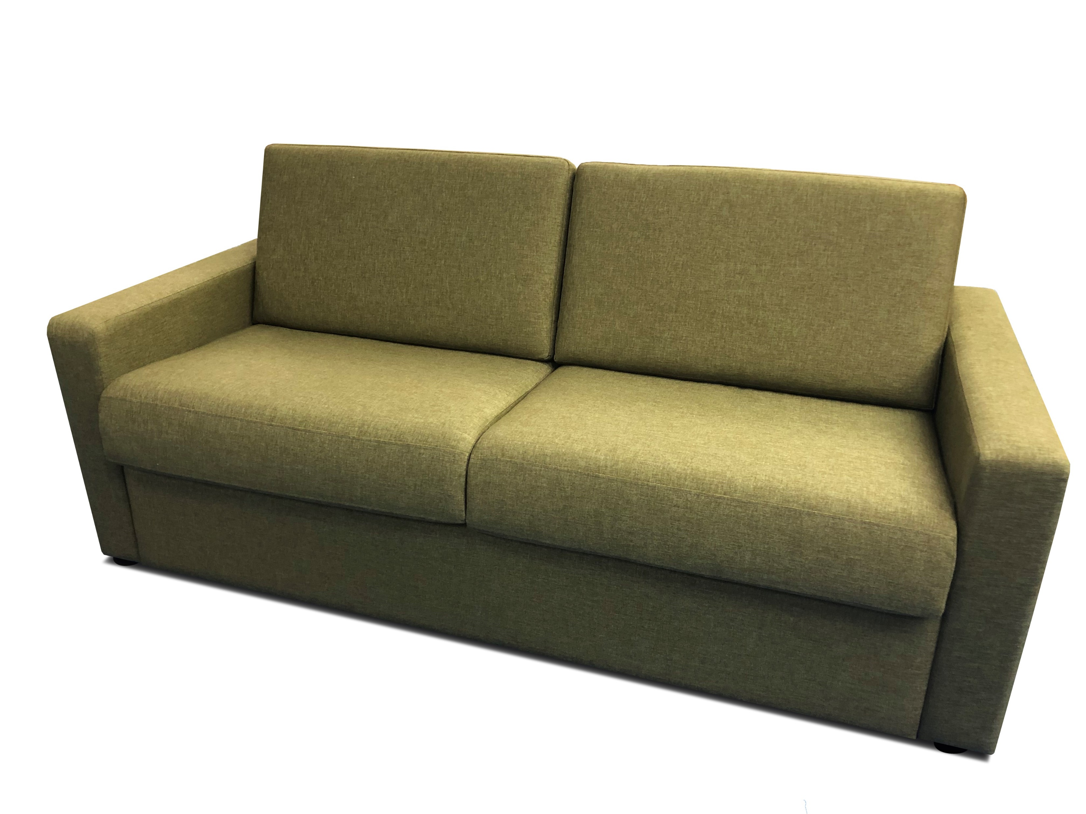
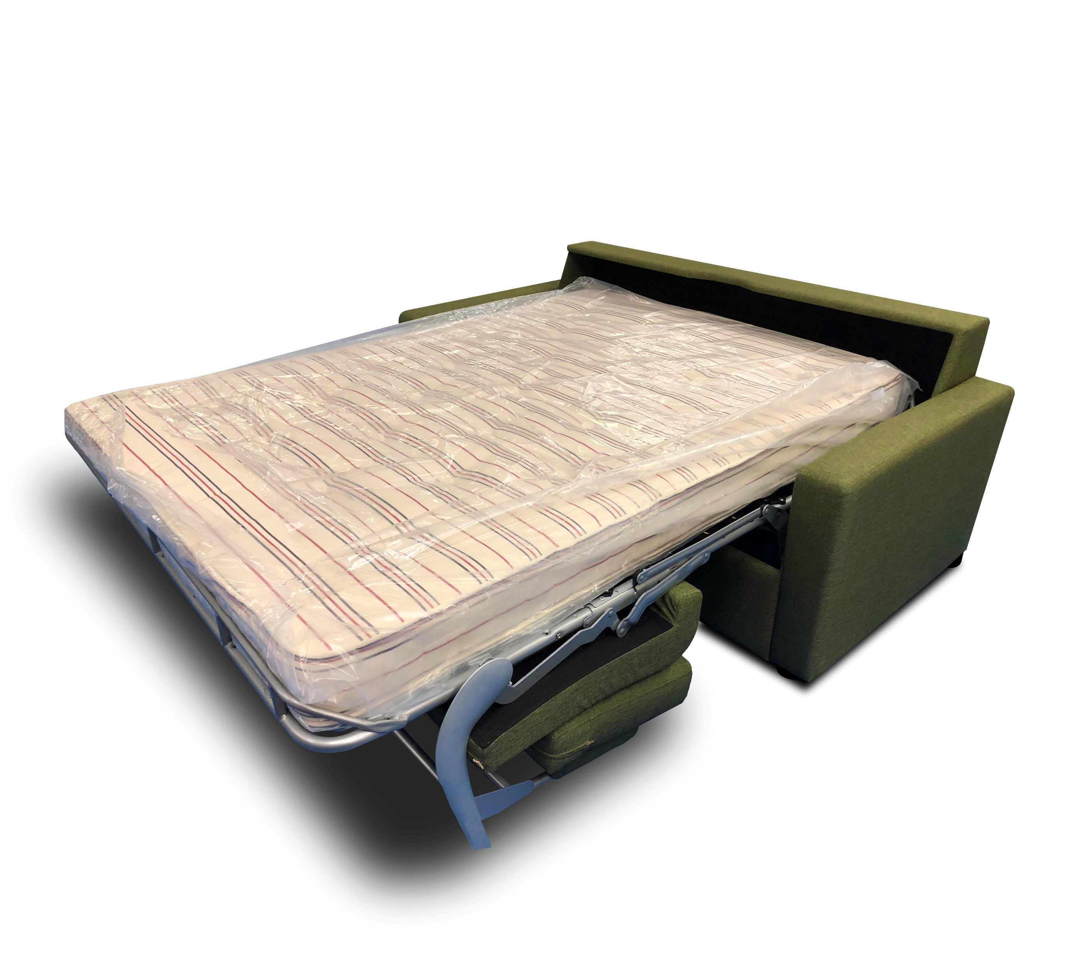
PREMIUM SOFA BED WITH POCKET SPRUNG MATTRESS

Slide 3
Mechanism comes with a full 5 year warranty
Mechanism comes with a full 5 year warranty
•Upholstery fabric as costed is for source 5 Lineta in all stocked colour options.
•Alternative fabric qualities and colour options available on request.
•COM fabric options are also considered.
•Alternative arm widths are also available as and if required with quotes issued upon request.
•The sofa mechanism is standard across all available options.(mechanism comes with a 5- year warranty)
•The mattress is a fully sprung 14 cm hand tufted mattress and is standard across all options at suitable for adults
•Bespoke designs are also considered but me be dependent on volume.
Restfull Nights we are committed to sustainable design and responsible sourcing, with all our products tested to BS7177:2008 (Crib 5)
Size Options (Sleep Area/External finished width)
Standard Arm
160cm 210cm(w) x 95cm(d) x 87cm (h)
140 cm 190cm (w) x 95cm(d) x 87cm (h)
120cm 170cm(w) x 95cm(d) x 87cm(h)
100cm 150cm(w)x 95cm(d) x 87cm(h)
80cm 130cm(w) x 95cm(d) x 87cm(h)
Slimmer arm options available

Slide 4
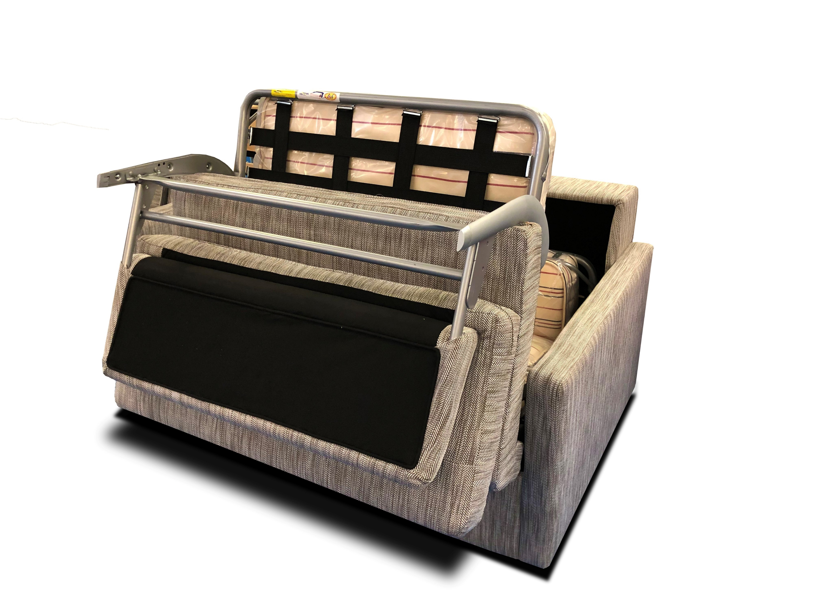

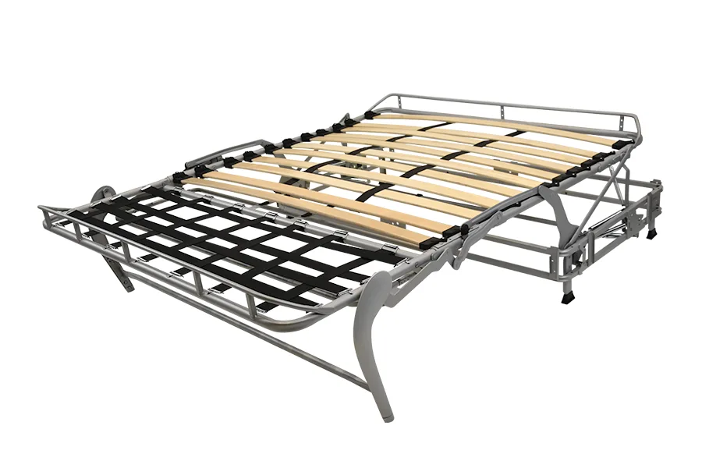
All in-one opening mechanism
Click link to see the opening process

